Slide 2
ADS FINAL PROJECT
FDA ADVERSE EVENT REPORTING SYSTEM
(FAERS)
Under Supervision of
Prof. Srikanth Krishnamurthy
Presented by
Team – 5
Ankit Bhayani(https://www. linkedin.com/in/bhayaniankit)
Rajat Agrawal(https://www.linkedin.com/in/ragraw26)
Vishakha Sawant(https://www. linkedin.com/in/vishakhasawant)

Slide 3



Presenter Introduction
ANKIT BHAYANI
Information systems graduate student at Northeastern University with an insatiable curiosity for technology.
https://www.linkedin.com/in/bhayaniankit/
RAJAT AGRAWAL
Information systems graduate student at Northeastern University with a passion for software designing and development
https://www.linkedin.com/in/ragraw26/
Vishakha Sawant
Information systems graduate student at Northeastern University with three years of IT experience.
https://www.linkedin.com/in/vishakhasawant/

Slide 4
PROBLEM STATEMENT
The problem addressed by this project is to classify the outcome of the drug reaction combination supplied to a patient based on the reported event. Since, we have different reported event by various organization we need to check whether the drug and reaction combination falls under following categories:
Death
Life-Threatening
Hospitalization
Initial or Prolonged
Disability
Congenital Anomaly
Required Intervention
Prevent Permanent Impairment/Damage
Other Serious (Important Medical Event)
Youtube link : https://www.youtube.com/watch?v=N8OrCHuN7BM

Slide 5
SUMMARY
Section 1: Data wrangling
Data Download and pre-processing
Exploratory Data analysis on Tableau
Section 2: Dockerizing the whole Process
Luigi Pipeline
Docker Image on Ubuntu
Result on Amazon S3
Section 3: Building and Evaluating Multi Class Classification Model
Classification using Multi-Class Logistic Regression, Multi-Class Random Forest, Multi-Class Neural Network, One vs All Multi-Class SVN Algorithms
Section 4: Creating User Interface for the FDA/Health Professional & User (Patient)
FDA/Health Professional: will use the user interface to predict the probability of the drug reaction -outcome based on certain parameters
User (Patient): Can search for adverse drug reaction which can be caused through a drug

Slide 6
TECHNOLOGY STACK
Python Scikit-learn library for applying Neural Network Classification Model
Azure ML Studio
Tableau for Data Visualization
Amazon ML Web service
Docker
JAVA EE for Web Development (Spring-MVC)
Deployment Server – Azure Cloud
Amazon S3

Slide 7
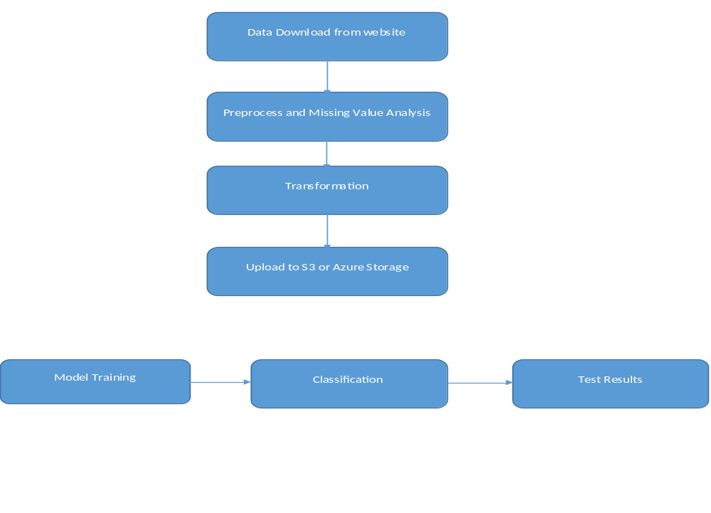
PROCESS FLOW DIAGRAM

Slide 8
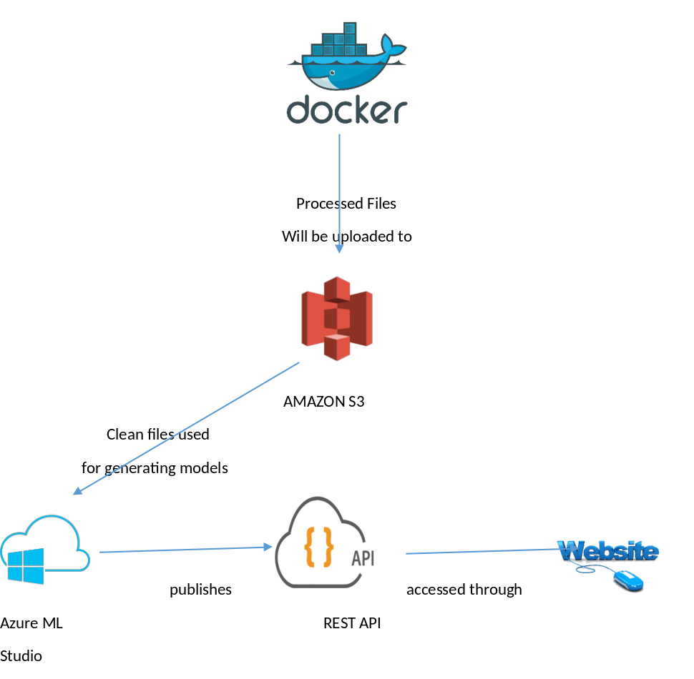
SYSTEM ARCHITECTURE

Slide 9
FAERS DATASET
The FDA Adverse Event Reporting System (FAERS) is a database that contains information on adverse event and medication error reports submitted to FDA.The FDA produces FDA Adverse Event Reporting System (FAERS) quarterly data. The FAERS include the following:
demographic and administrative information and the initial report image ID number (if available)
drug information from the case reports;
reaction information from the reports;
patient outcome information from the reports
information on the source of the reports
a "README" file containing a description of the files
The FDA provides a lot of additional information about the FAERS. FDA Adverse Event Reporting System (FAERS) began 2012Q4.
Legacy Adverse Event Reporting System (AERS) are available 2004Q1-2012Q3. we have used FAERS variable names in the AERS files in cases where the variables are the same.

Slide 10
Data Download & Pre-Processing:
To download the file programmatically, without any manual intervention we have used the python requests library to navigate to the website and created source directory (FAERSsrc), where all the related files will be downloaded and destination directory where all the files required for our analysis will be saved.
We will be using Beautiful Soup package, a powerful python package for data scrapping from the FDA website and download all the quarterly files for the “FAERS” files for our analysis purpose.
After getting the files from the FDA website, we will download all the quarter file in unzipped formed on our local and delete all the irrelevant files which are not required for our analysis. For handling this, we have a deleted the files in XML (present in pdf format) format and ReadMe files.
As we will have files in different folder depending on the quarter data, we will move all the required file into a destination folder

Slide 11
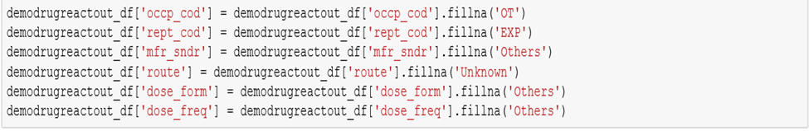
Data Preprocessing & Cleaning
We have used the standard Reaction Name as proposed by MedDRA or Medical Dictionary for Regulatory Activities which is a clinically validated international medical terminology dictionary used by regulatory authorities in the pharmaceutical industry.
For Drug Name standardization, we have used RxNorm provides normalized names for clinical drugs and links its names to many of the drug vocabularies commonly used in pharmacy management
Once, we are done with the cleaning of all the four files, we will create a summarized data set using the python joins file based on primary report id and case id. For this step, we created a function which will join all the four-data frame associated with the final data set.

Slide 12
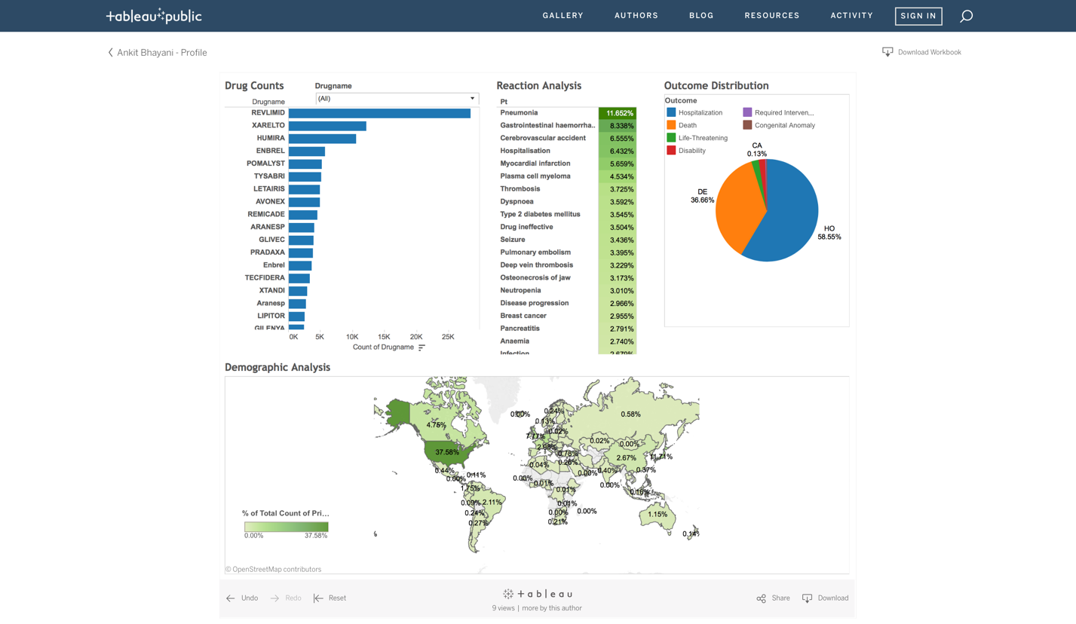
Exploratory Data Analysis
FAERsDataset- DrugReaction Effects Analysis Dashboard:

Slide 13
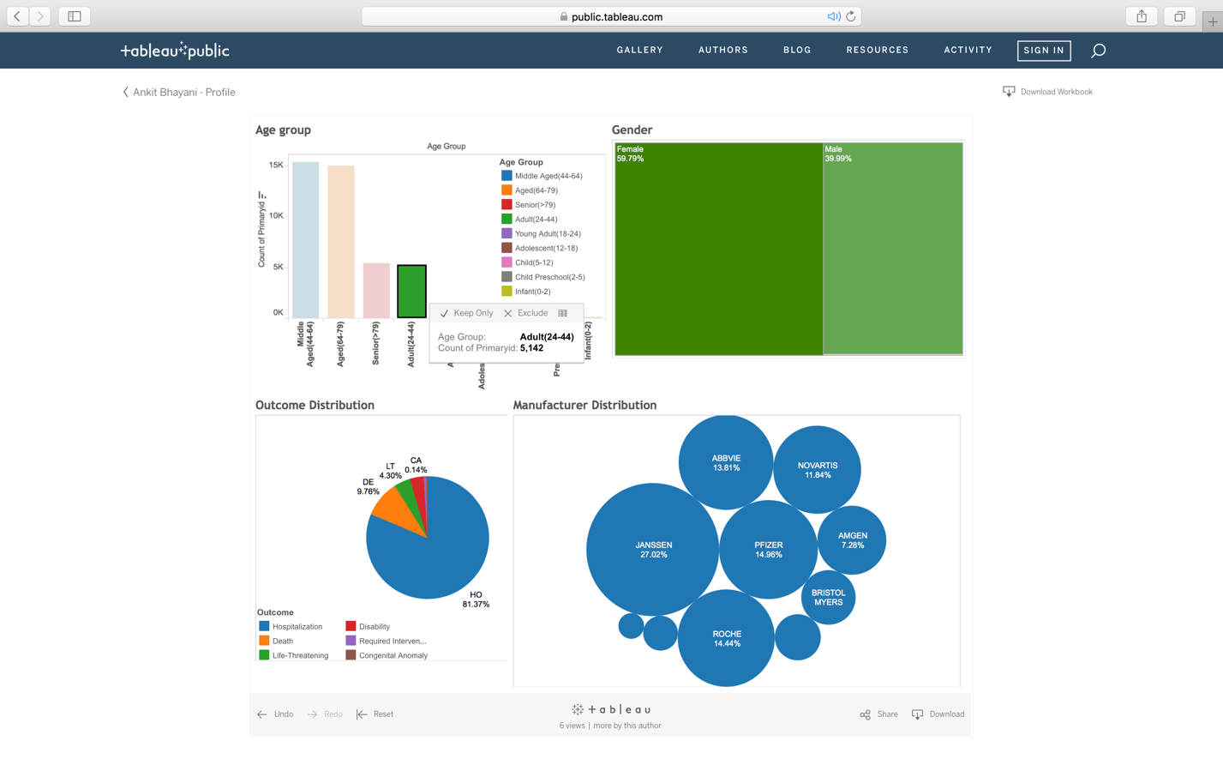
Outcomes on AgeGroup, Gender and Manufacturer

Slide 14
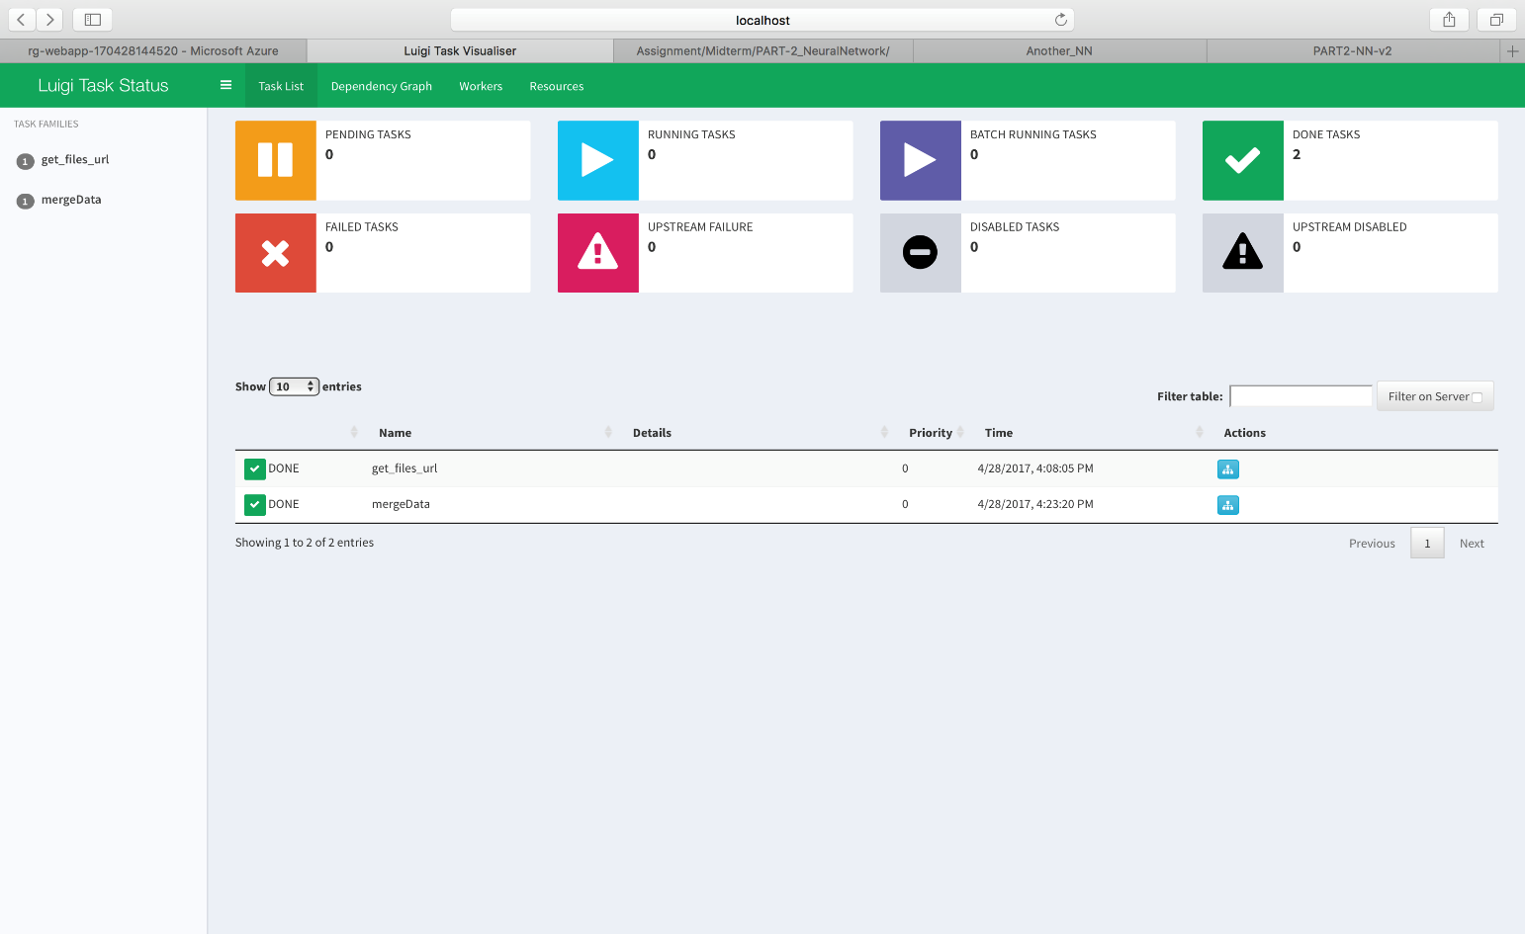
DOCKERIZING THE PROCESS
LUIGI is a Python-based framework for expressing data pipelines. Everything in Luigi is in Python.
Luigi performs following functions in a pipeline for downloading and creating the processed-out file:
get_files_Urls-Fetching urls for file download
mergeData-Merging and Cleaning all the data from all downloaded file into a single file

Slide 15
DOCKER RUN INSTRUCTIONS:
Pull an image from dockerhub:
docker pull ankitbhayani/finalprojectads2017
Run the docker image
docker run -e ACCESS_KEY=<YOUR_ACCESS_KEY>
-e SECRET_KEY=<YOUR_SECRET_KEY>
-e S3_PATH=<YOUR_S3_PATH>
-e REGION=<BUCKET_REGION>
ankitbhayani/finalprojectads2017
/src/driverShell.sh

Slide 16
MULTI - CLASS CLASSIFICATION
In our cleaned FAERS dataset, we have a column named outc_cod, which signifies the primary outcome for e.g. (‘OT’,’DE’) drug intake and reaction occurs. In our project, we are using multi-class classification to predict the probability of the outcome based on features selected from feature engineering.
CODE MEANING_TEXT
---- ------------
DE Death
LT Life-Threatening
HO Hospitalization - Initial or Prolonged
DS Disability
CA Congenital Anomaly
RI Required Intervention to Prevent
Permanent Impairment/Damage
OT Other

Slide 17
APPROACH:CLASSIFCATION
We will use three approaches to find out the outcome of our classification model:
Using Azure ML Studio (For selecting the best model for our problem)
Using Amazon ML web service (uses Stochastic gradient descent)
Python Sklearn Library to test Neural Network

Slide 18
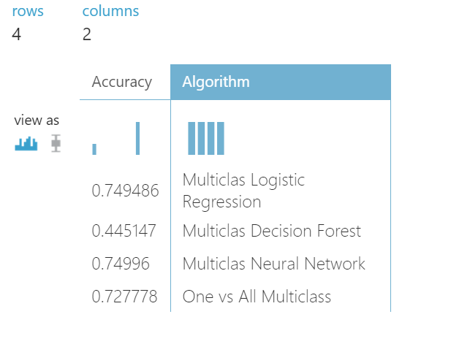
COMPARINING DIFFERENT MODELS

Slide 19
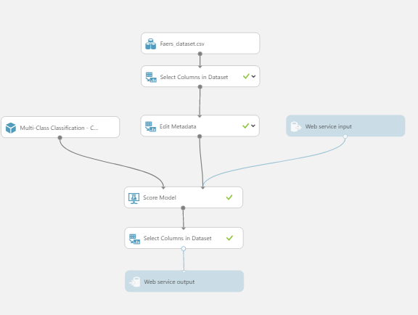
IMPLEMENTING CLASSIFICATION MODEL ON AZURE ML
MULTI_CLASS NEURAL NETWORK CLASSIFICATION

Slide 20
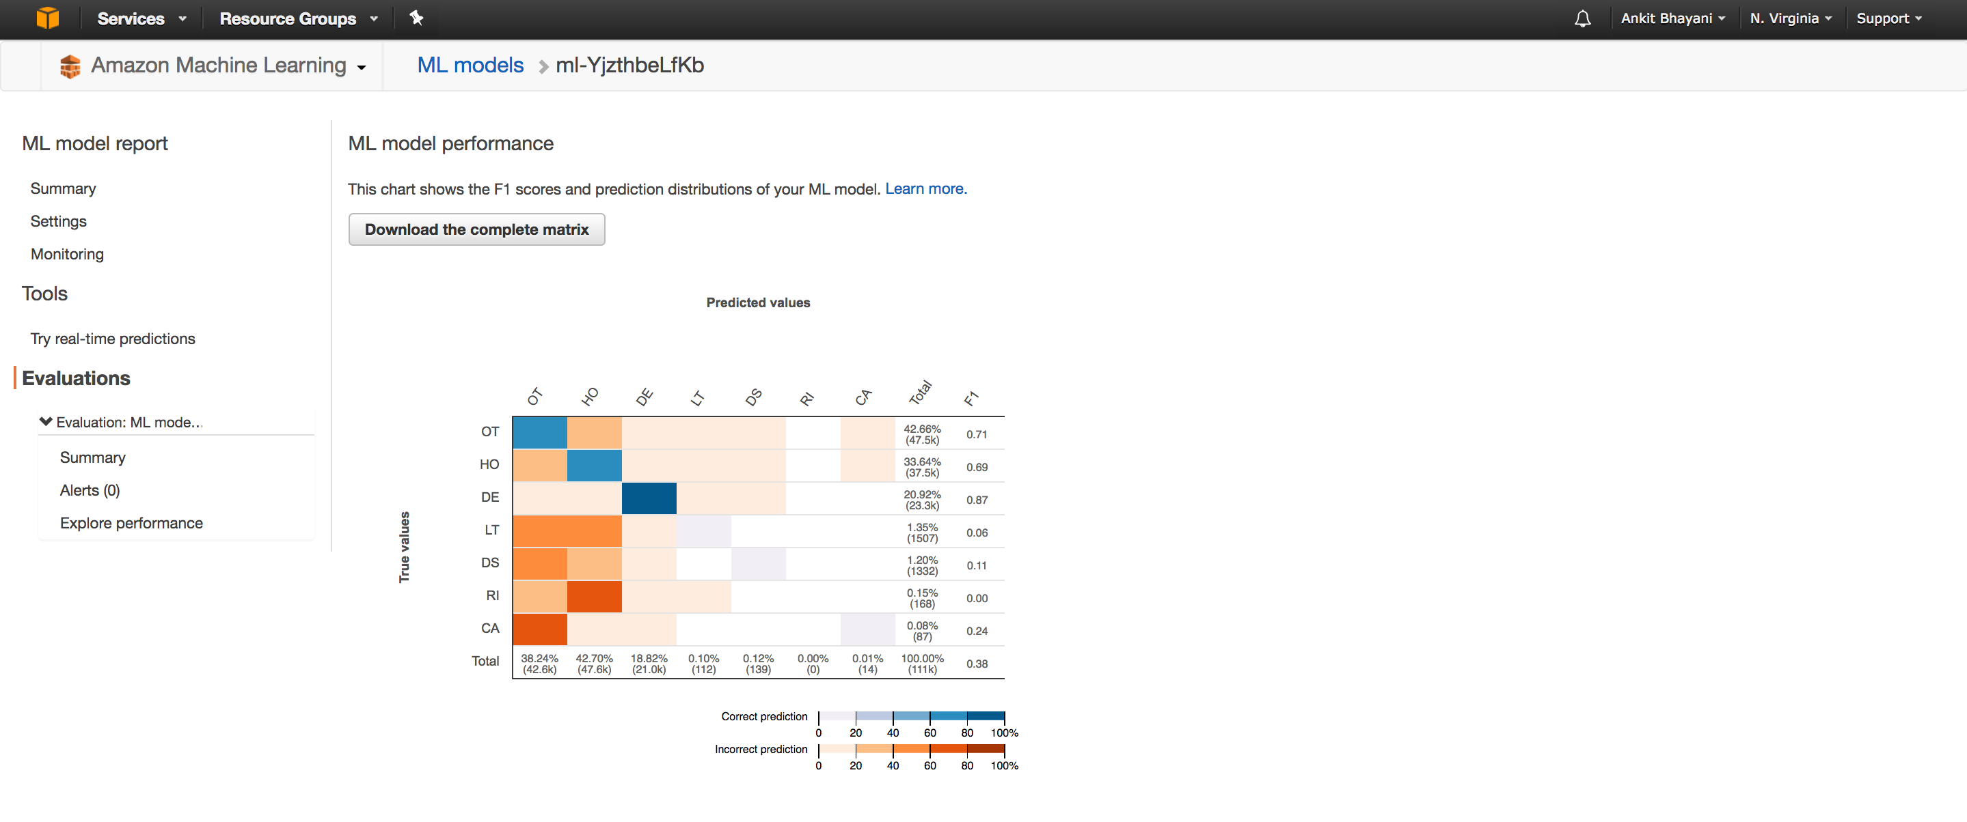
AMAZON MACHINE LEARNING WEBSERVICE

Slide 21
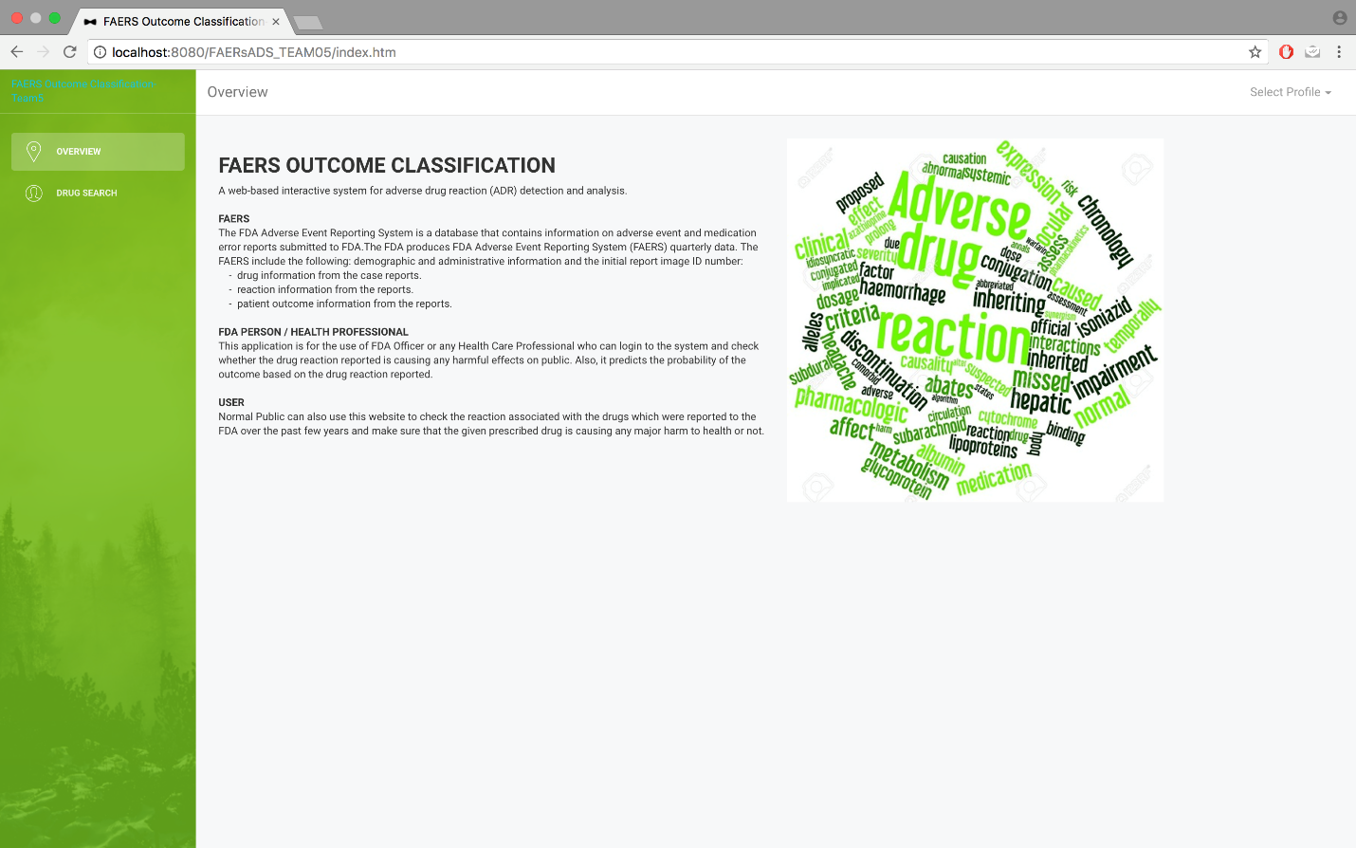
WEBSITE
URL : http://faersoutcomeclassificationteam05.azurewebsites.net/FAERsADS_TEAM05/index.htm

Slide 22
FDA USERS
FDA PERSON / HEALTH PROFESSIONAL
This application is for the use of FDA Officer or any Health Care Professional who can login to the system and check whether the drug reaction reported is causing any harmful effects on public. Also, it predicts the
probability of the outcome based on the drug reaction reported.
USER
Normal Public can also use this website to check the reaction associated with the drugs which were reported to the FDA over the past few years and make sure that the given prescribed drug is causing any major harm to health or not.

Slide 23
FDA PERSON / HEALTH PROFESSIONAL
FDA Person will check on which drug reaction combination classification and its corresponding percentage distribution coming from ML model trained using Neural Network
FDA Person will select the following fields from the drop down:
Drug Name
Route
Dose Amount
Dose Unit
Dose Form
Dose Frequency
Manufacture Details
Reaction
He will get the following outcome:
Scored Probabilities of all the Outcome caused by Drug/Reaction
Hi-Charts showing the scored Probabilities
The one with Highest Scored Label will be classified as the predicted class of the input.

Slide 24
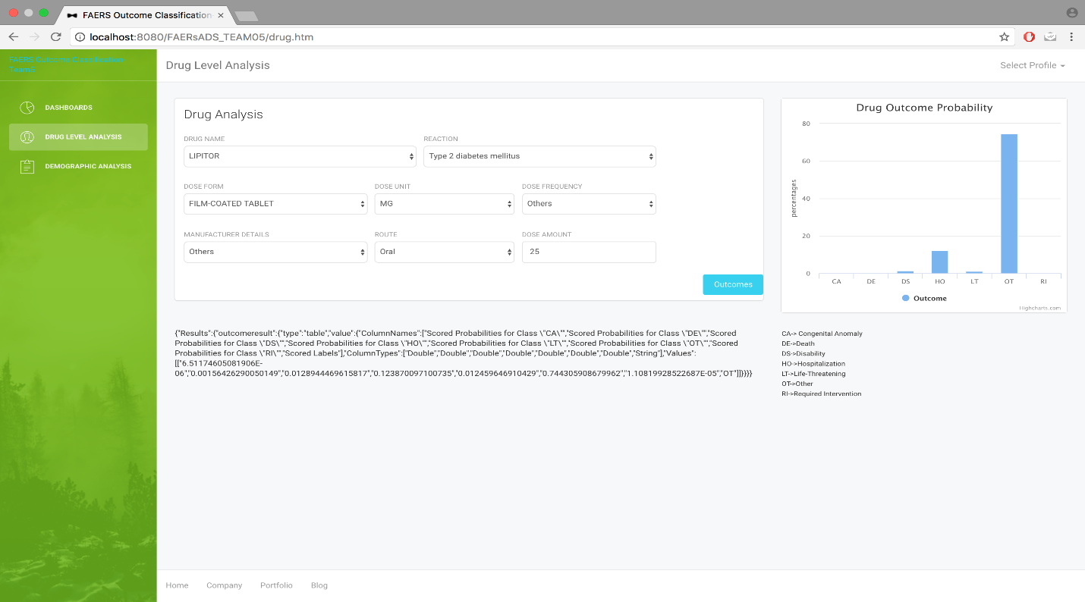

Slide 25
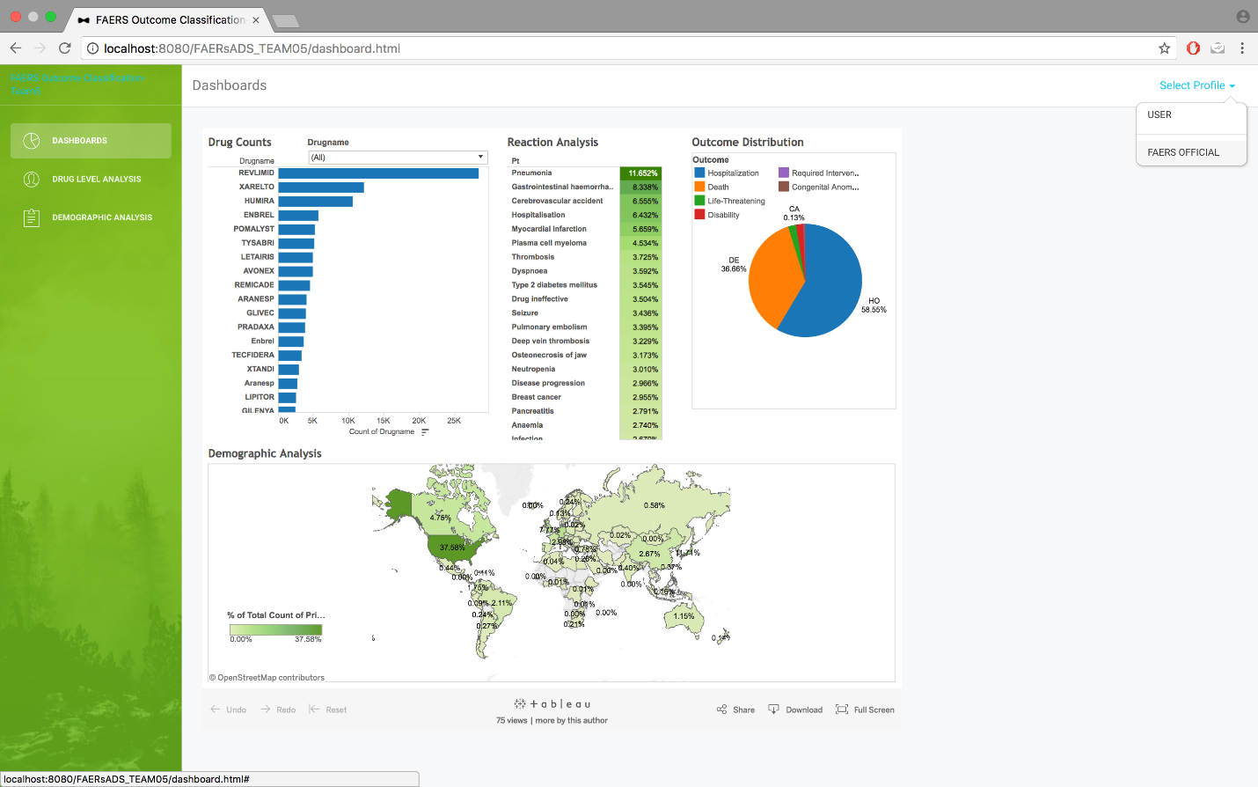

Slide 26
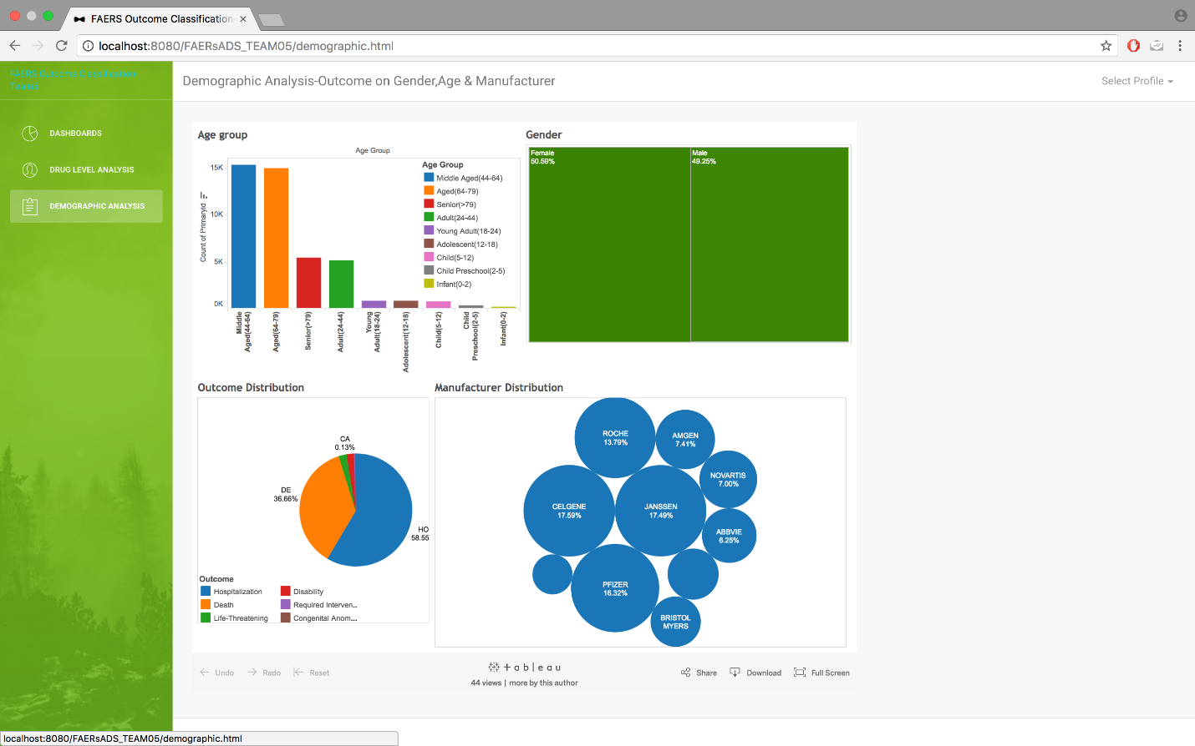

Slide 27
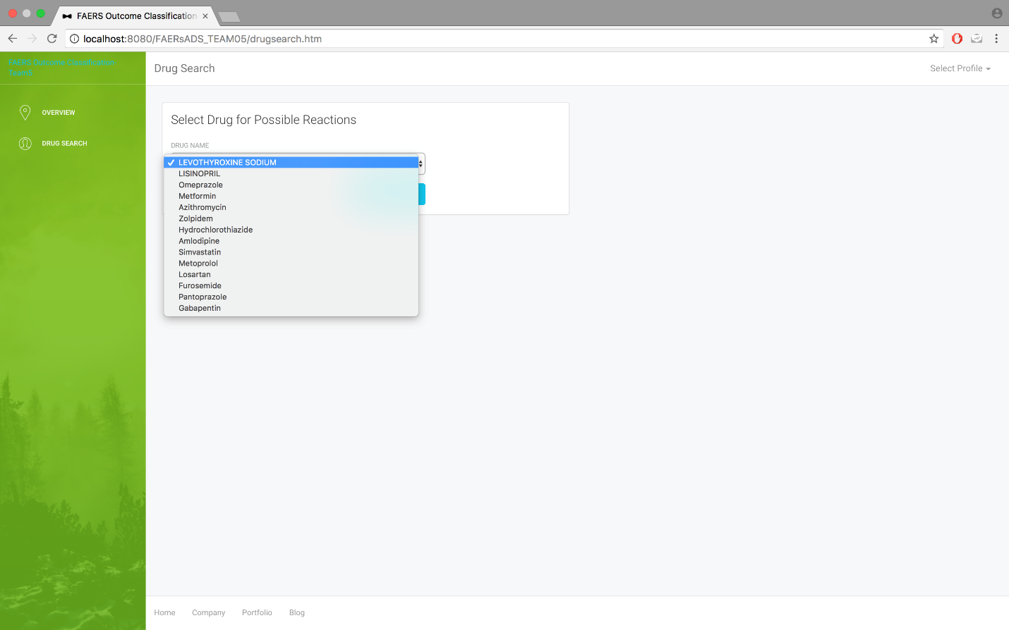
User
A normal user can visit the site and select the drug list from drop the list of drugs

Slide 28
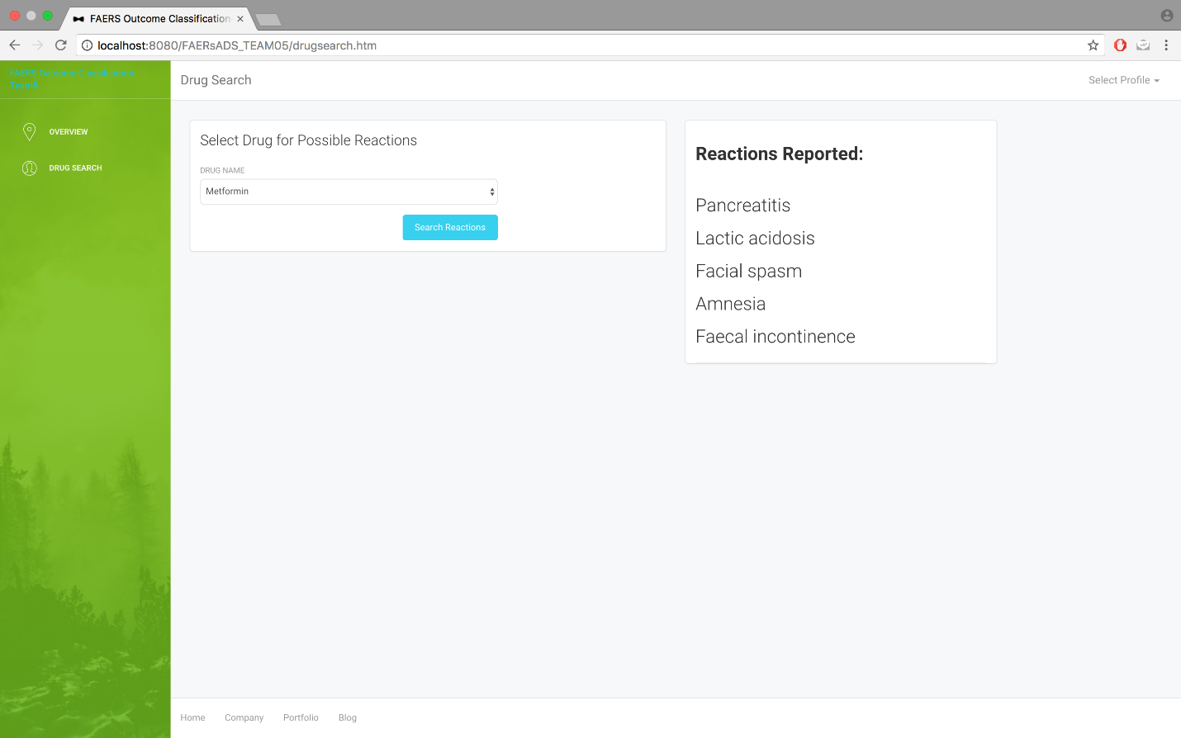

Slide 29
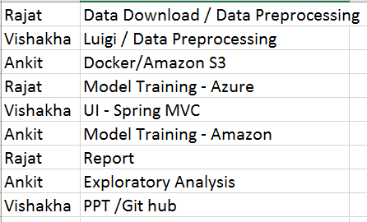
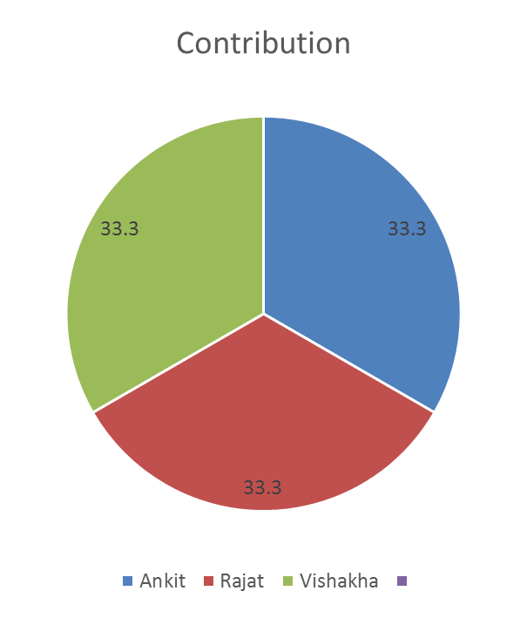
CONTRIBUTION

Slide 30
THANK YOU!!!!

